Slide 1

Week 3 Hour 1

Slide 2
Learning Objectives
Be familiar with the test data record sheet template
Understand how this relates to Part 2 of the Portfolio
Work through practice questions

Slide 3
Practice Materials
We can give guidance on these, but not the assessment materials
Guidance can be sought in the forum and workshop sessions
Please do consider setting up a study-group to go through these on teams

Slide 4
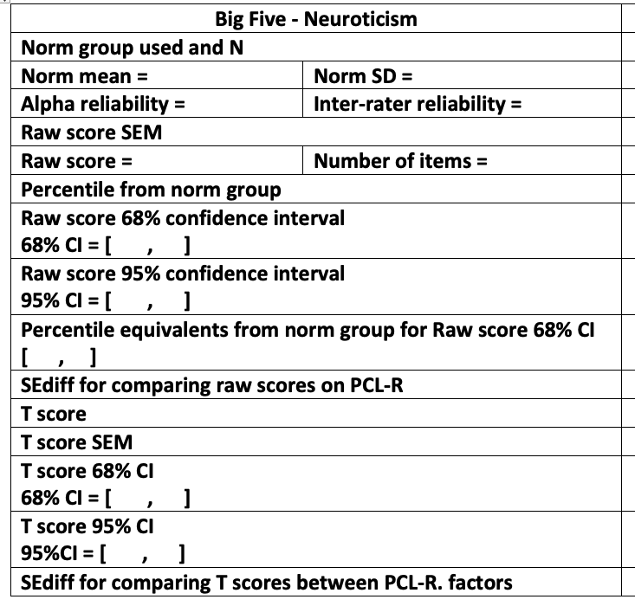
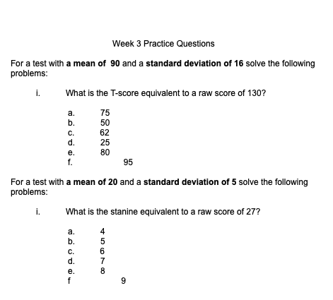
Practice Materials

Slide 5
Practice Data-Record Sheet
Big Five - Neuroticism
Norm group used and N
Unidimensional = | Tau Equivalent =
Norm mean = | Norm SD =
Alpha reliability = | Omega Reliability =
Raw score SEM
Raw score = | Number of items =
Percentile from norm group
Raw score 68% confidence interval 68% CI = [ , ]
Raw score 95% confidence interval 95% CI = [ , ]
100 MMU MSc Students
TRUE
FALSE
4.27
0.613
0.824
0.829
0.613 * √1-.829 = 0.25
3.5
10
10th
3.5 ± 0.25
3.5 ± (2 x 0.25)

Slide 6

Task 3
Work through the data record sheet for one of the Big Five factors
Notes:
Breakout room study groups? https://padlet.com/oclark15/gokuco1h7g9kr2sr

Slide 7
Post-Session Activity
Post-session reading
Activities
Practice data record sheet
Practice worksheet questions
Start working on your own dataset
We encourage you to work in groups!

